Slide 1
METU RUZGEM SETUP Measurements Analaysis
FFT analysis
by S.Ozkucuk

Slide 2
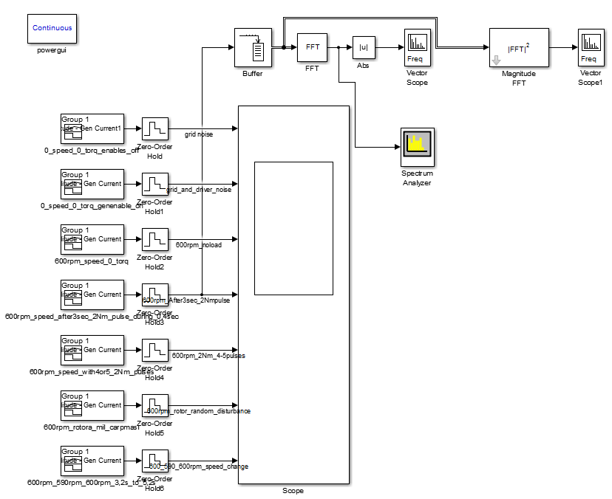
Simulink

Slide 3
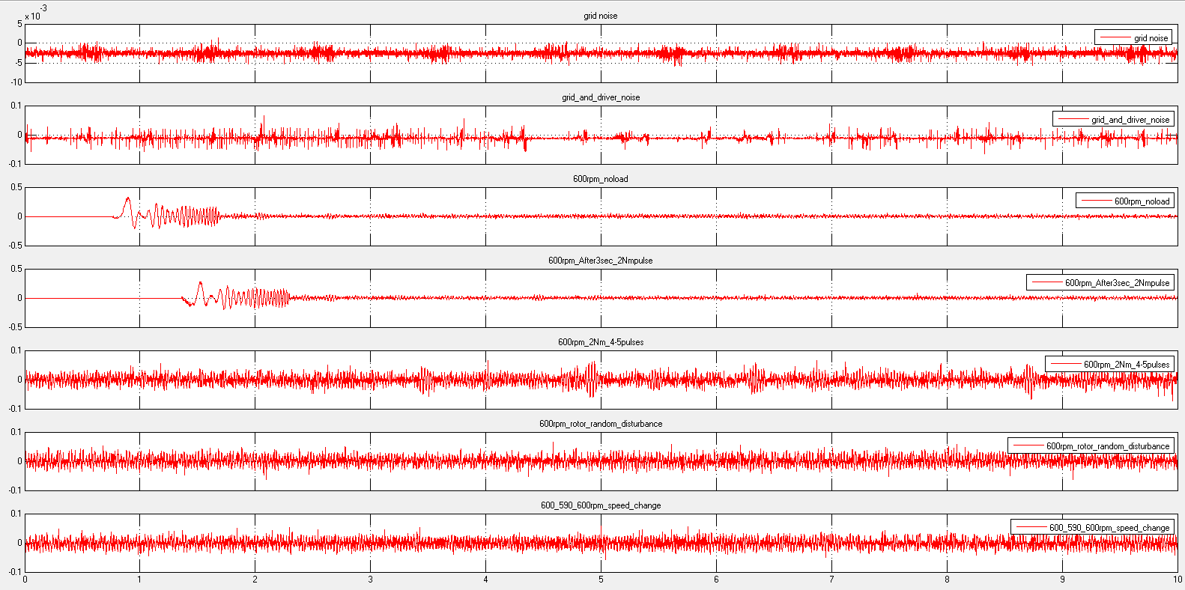
Time domain

Slide 4
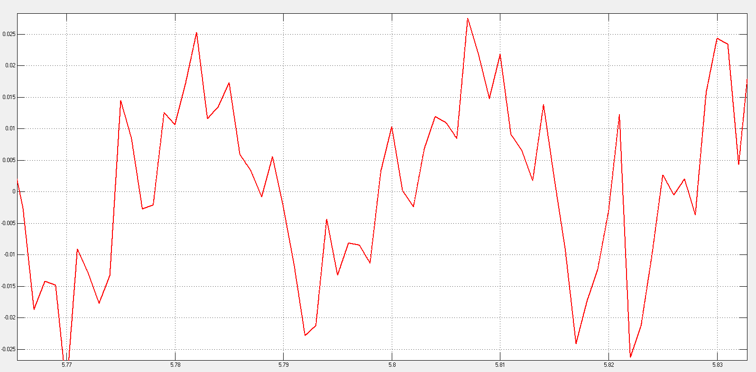
600rpm no load phase current

Slide 5
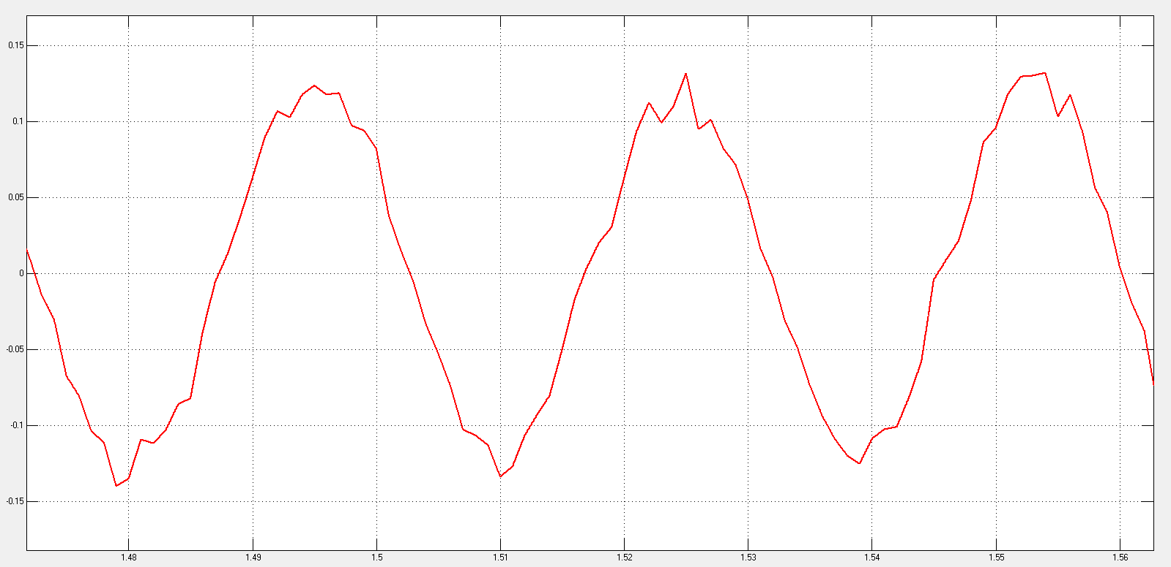
600rpm starting full load

Slide 6
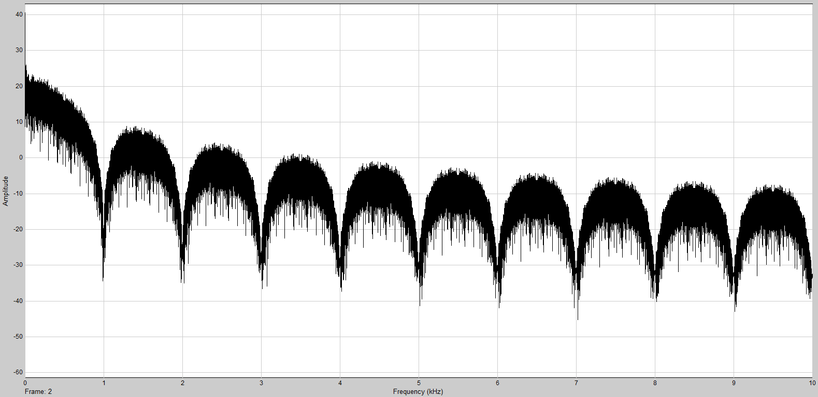
Grid + Driver noise

Slide 7
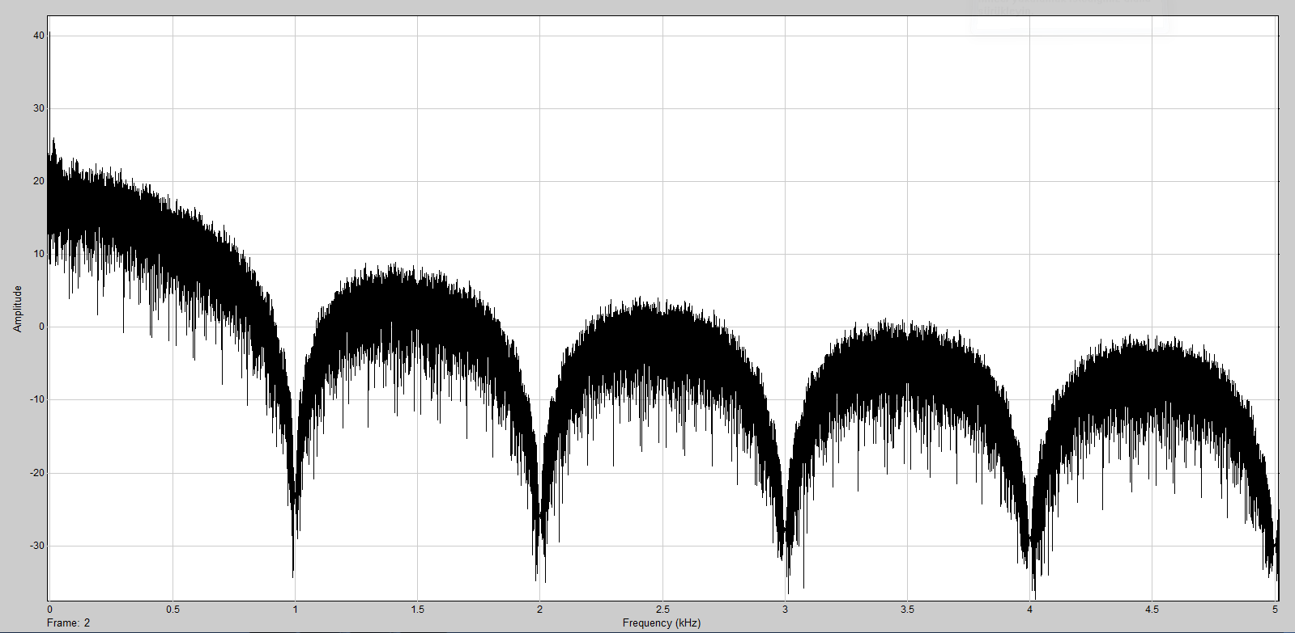
Grid + driver noise zoom

Slide 8
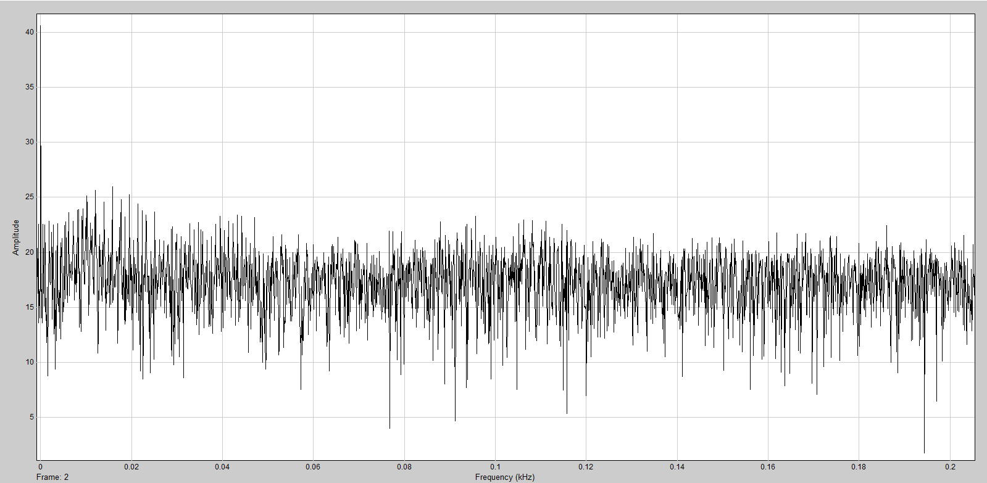
Grid + driver noise zoom 0-200Hz

Slide 9
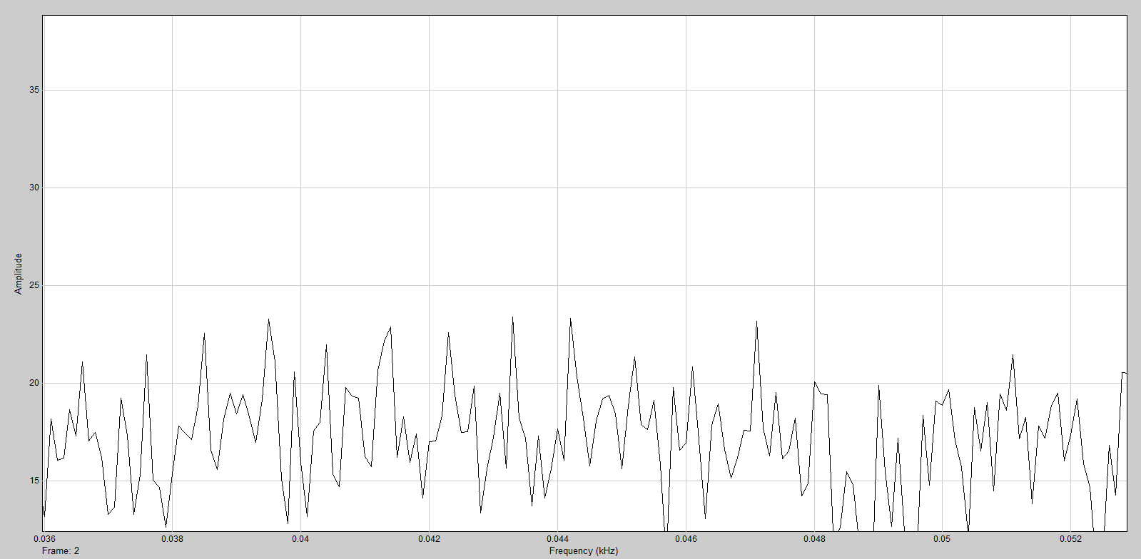
Grid + driver noise zoom 36-52 Hz

Slide 10
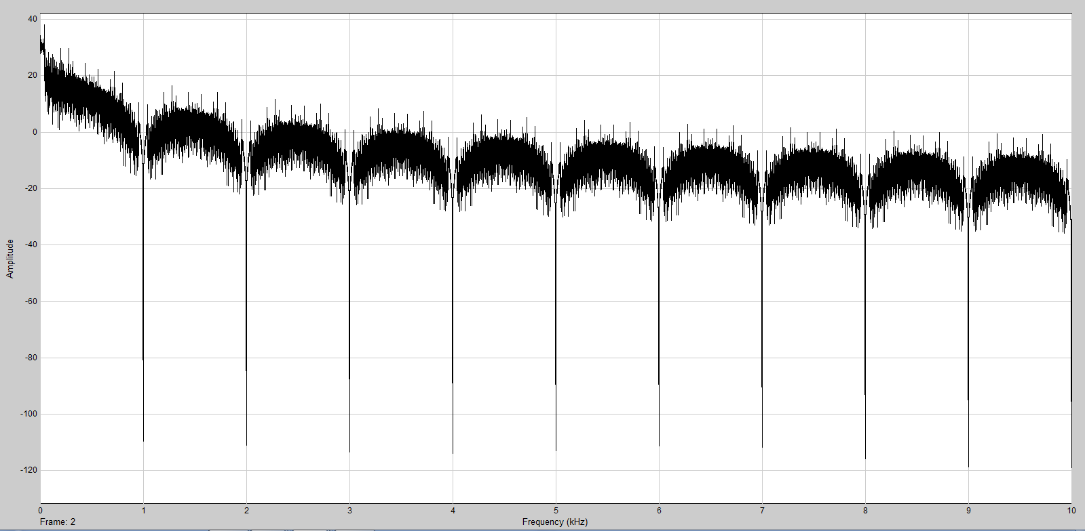
600rpm no load

Slide 11
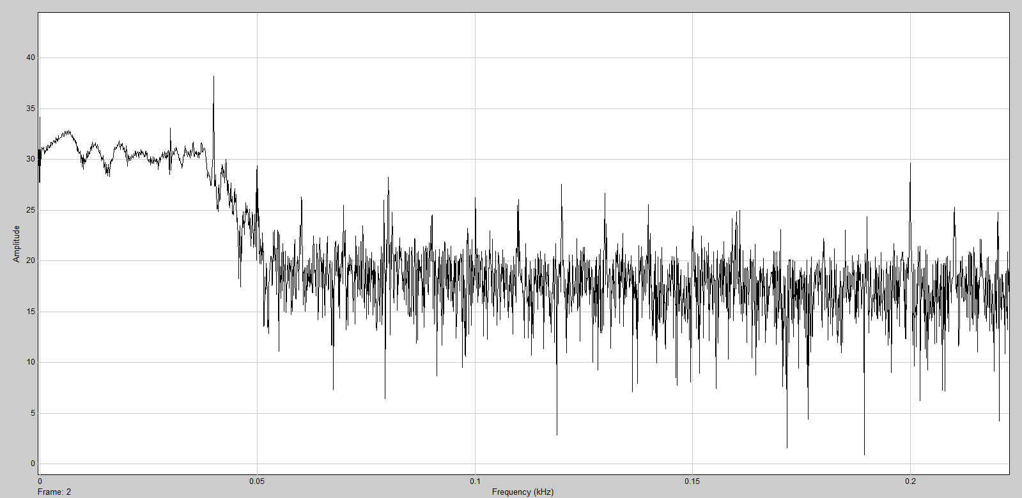
600rpm noload – 8pole PMSG-40Hz

Slide 12
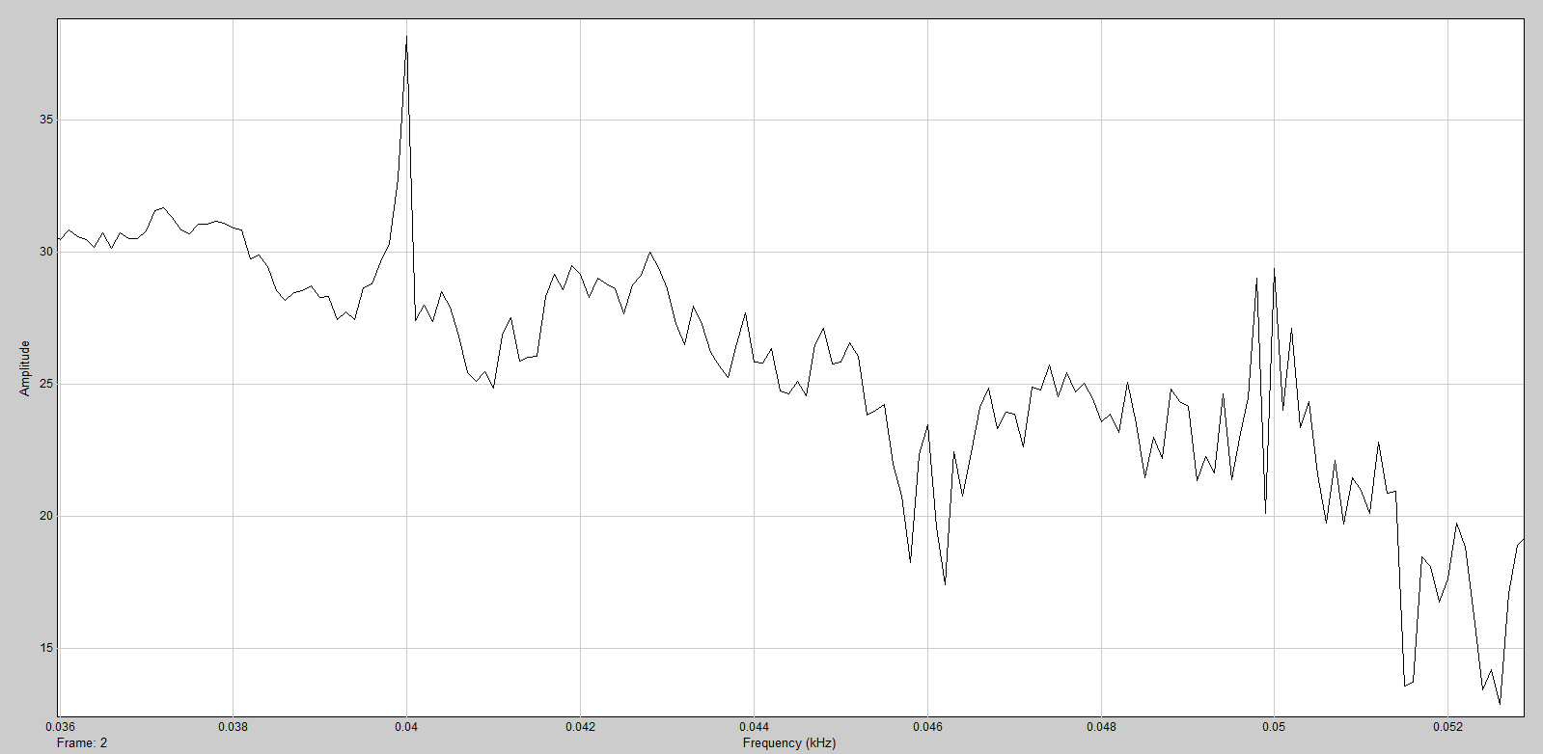
600rpm noload – 8pole PMSG-40Hz
fundamental
Grid

Slide 13
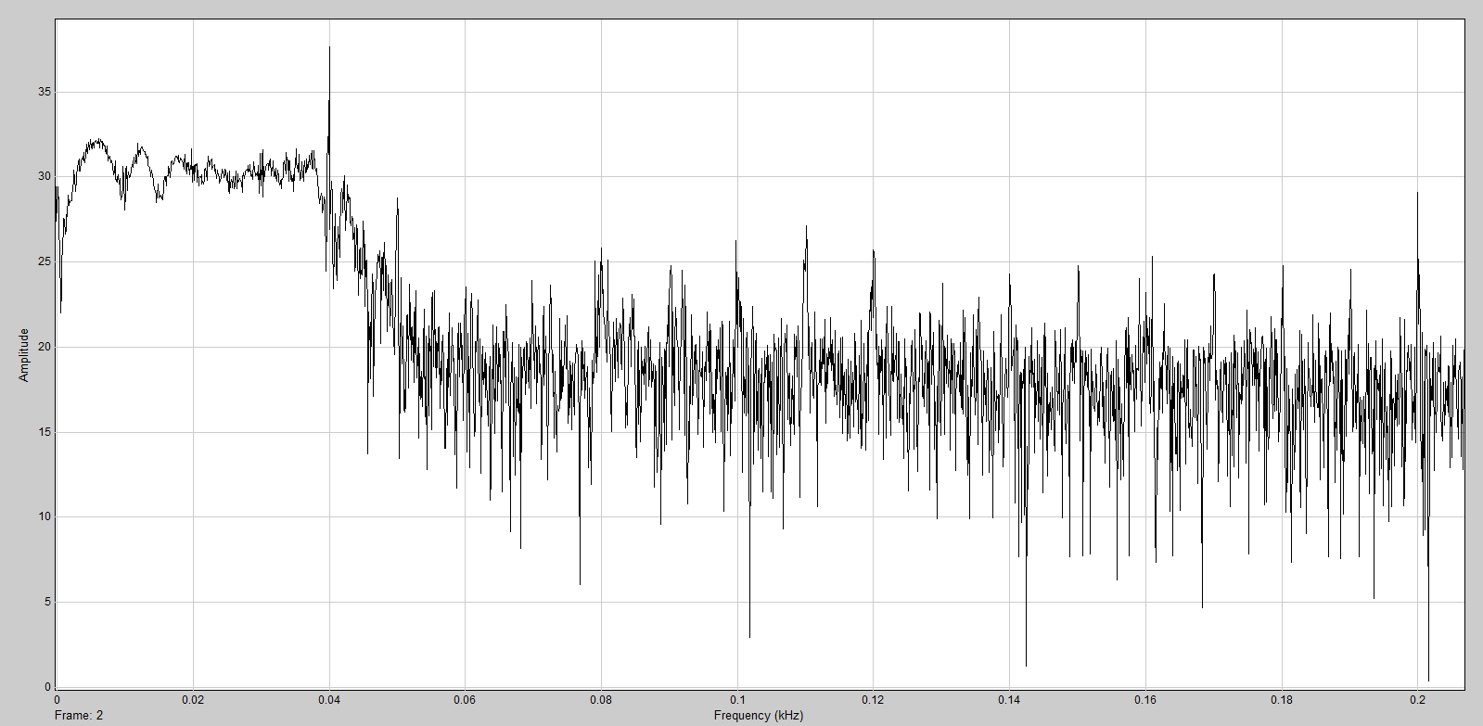
600rpm no load + 2Nm pulse

Slide 14
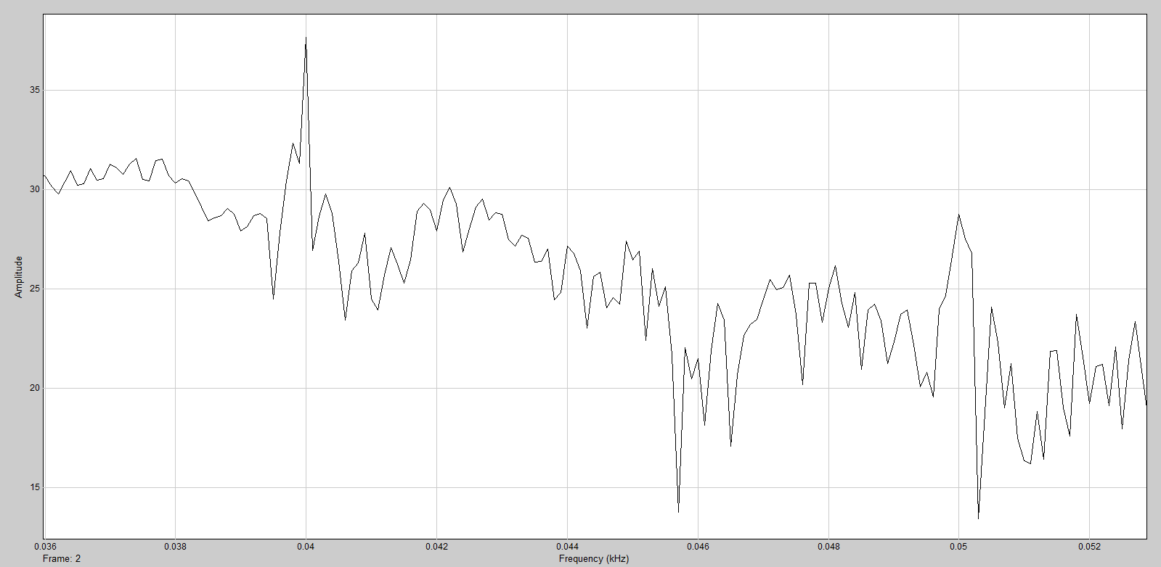
600rpm no load + 2Nm pulse zoom

